Slide 1
Unit 6 Live Session Powerpoint

Slide 2
For Live Session: Part 1 (3-5 hours)
Download the training set: Connect to the opendatasoft website and download the random sample of 891 Titanic Passengers. This is the training set. The data come in JSON form format and you can use this URL to access the data:
https://public.opendatasoft.com/api/records/1.0/search/?dataset=titanic-passengers&rows=2000&facet=survived&facet=pclass&facet=sex&facet=age&facet=embarked
Hint: This is not trivial. I recommend that you use the jsonlite package (fromJSON()) and RCurl package (getURL()) to access the data. (We covered this in Unit 4).
Try your best to access the data using the URL. You may also find the data (titanic_train.csv) on github. We will go over this data ingestion in live session.
Use KNN to classify those who survived and died based on Age and class.
Use your age and predict your survival based on each of the ticket classes.
Use your model to classify the 418 randomly selected passengers in the test set (titanic_test.csv) on github.
Create a confusion matrix and calculate the accuracy, misclassification rate, sensitivity and specificity. Be prepared to explain these statistics. (It is ok if you have questions here… we will answer them in live session … just do your best in the time allotted.)
Make a PowerPoint to present in Live Session
BONUS: Create separate models for males and females and compare the resulting classification statistics after using the models to classify those in the test set.

Slide 3
For Live Session: Part 1 (3-5 hours)
Download the training set: Connect to the opendatasoft website and download the random sample of 891 Titanic Passengers. This is the training set. The data come in JSON form format and you can use this URL to access the data:
https://public.opendatasoft.com/api/records/1.0/search/?dataset=titanic-passengers&rows=2000&facet=survived&facet=pclass&facet=sex&facet=age&facet=embarked
Hint: This is not trivial. I recommend that you use the jsonlite package (fromJSON()) and RCurl package (getURL()) to access the data. (We covered this in Unit 4).
Try your best to access the data using the URL. You may also find the data (titanic_train.csv) on github. We will go over this data ingestion in live session.
Use KNN to classify those who survived and died based on Age and class.
titanicJSON = getURL("https://public.opendatasoft.com/api/records/1.0/search/?dataset=titanic-passengers&rows=2000&facet=survived&facet=pclass&facet=sex&facet=age&facet=embarked")
titanicData = fromJSON(titanicJSON)
titanicDataDF = titanicData$records$fields #grab the data.frame out of the list
trainIndex = sample(seq(1:891), 650) #randomly select indices for the training set
trainTitanic = titanicDataDF[trainIndex,]. # randomly assign the training set
testTitanic = titanicDataDF[-trainIndex,]. # assign the test set to be what was left over from the training set.
#classify the test set observations from the model fit on the training set
classifications = knn(trainTitanic[(!is.na(trainTitanic$age) & !is.na(trainTitanic$pclass)),c(4,6)],testTitanic[(!is.na(testTitanic$age) & !is.na(testTitanic$pclass)),c(4,6)],trainTitanic$survived[(!is.na(trainTitanic$age) & !is.na(trainTitanic$pclass))], prob = TRUE, k = 5)

Slide 4
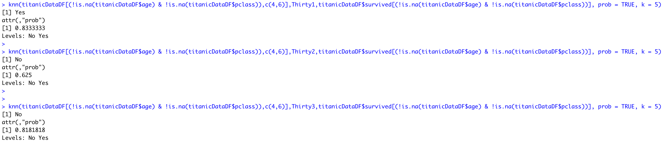
For Live Session: Part 1 (3-5 hours)
Download the training set: Connect to the opendatasoft website and download the random sample of 891 Titanic Passengers. This is the training set. The data come in JSON form format and you can use this URL to access the data:
https://public.opendatasoft.com/api/records/1.0/search/?dataset=titanic-passengers&rows=2000&facet=survived&facet=pclass&facet=sex&facet=age&facet=embarked
Hint: This is not trivial. I recommend that you use the jsonlite package (fromJSON()) and RCurl package (getURL()) to access the data. (We covered this in Unit 4).
Try your best to access the data using the URL. You may also find the data (titanic_train.csv) on github. We will go over this data ingestion in live session.
Use KNN to classify those who survived and died based on Age and class.
Use your age and predict your survival based on each of the ticket classes.
#Predicting Survial for a 30 year old in 1st,2nd,3rd class
Thirty1= data.frame(aga = 30, pclass = 1)
Thirty2= data.frame(aga = 30, pclass = 2)
Thirty3= data.frame(aga = 30, pclass = 3)

Slide 5
For Live Session: Part 1 (3-5 hours)
Download the training set: Connect to the opendatasoft website and download the random sample of 891 Titanic Passengers. This is the training set. The data come in JSON form format and you can use this URL to access the data:
https://public.opendatasoft.com/api/records/1.0/search/?dataset=titanic-passengers&rows=2000&facet=survived&facet=pclass&facet=sex&facet=age&facet=embarked
Hint: This is not trivial. I recommend that you use the jsonlite package (fromJSON()) and RCurl package (getURL()) to access the data. (We covered this in Unit 4).
Try your best to access the data using the URL. You may also find the data (titanic_train.csv) on github. We will go over this data ingestion in live session.
Use KNN to classify those who survived and died based on Age and class.
Use your age and predict your survival based on each of the ticket classes.
Use your model to classify the 418 randomly selected passengers in the test set (titanic_test.csv) on github.
# Classify the 418 from the other test set. We don't have the true labels for these... you can get a score for these by submitting them to Kaggle. (where I got the test set from.)
testTitanicKaggle = read.csv(file.choose(),header = TRUE)
names(testTitanicKaggle)[2] = "pclass"
names(testTitanicKaggle)[5] = "age"
testTitanicKaggleClean = testTitanicKaggle[(!is.na(testTitanicKaggle$pclass) & !is.na(testTitanicKaggle$age)),]
classifications = knn(trainTitanic[(!is.na(trainTitanic$age) & !is.na(trainTitanic$pclass)),c(4,6)],testTitanicKaggleClean[,c(5,2)],trainTitanic$survived[(!is.na(trainTitanic$age) & !is.na(trainTitanic$pclass))], prob = TRUE, k = 5)

Slide 6
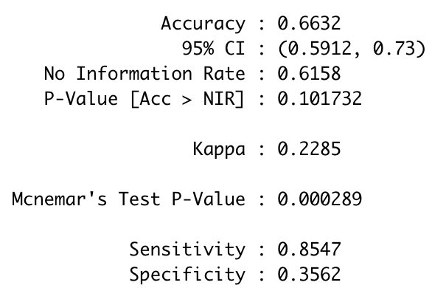
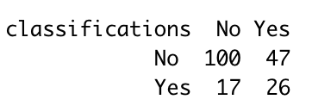
For Live Session: Part 1 (3-5 hours)
Download the training set: Connect to the opendatasoft website and download the random sample of 891 Titanic Passengers. This is the training set. The data come in JSON form format and you can use this URL to access the data:
https://public.opendatasoft.com/api/records/1.0/search/?dataset=titanic-passengers&rows=2000&facet=survived&facet=pclass&facet=sex&facet=age&facet=embarked
Hint: This is not trivial. I recommend that you use the jsonlite package (fromJSON()) and RCurl package (getURL()) to access the data. (We covered this in Unit 4).
Try your best to access the data using the URL. You may also find the data (titanic_train.csv) on github. We will go over this data ingestion in live session.
Use KNN to classify those who survived and died based on Age and class.
Use your age and predict your survival based on each of the ticket classes.
Use your model to classify the 418 randomly selected passengers in the test set (titanic_test.csv) on github.
Create a confusion matrix and calculate the accuracy, misclassification rate, sensitivity and specificity. Be prepared to explain these statistics. (It is ok if you have questions here… we will answer them in live session … just do your best in the time allotted.)
classifications = knn(trainTitanic[(!is.na(trainTitanic$age) & !is.na(trainTitanic$pclass)),c(4,6)],testTitanic[(!is.na(testTitanic$age) & !is.na(testTitanic$pclass)),c(4,6)],trainTitanic$survived[(!is.na(trainTitanic$age) & !is.na(trainTitanic$pclass))], prob = TRUE, k = 5)
table(classifications,testTitanic$survived[(!is.na(testTitanic$age) & !is.na(testTitanic$pclass))])
CM = confusionMatrix(table(classifications,testTitanic$survived[(!is.na(testTitanic$age) & !is.na(testTitanic$pclass))]))
Actual
Accuracy: 126 / 190 = .663
Misclassification: 1 - .663 = .337
Sensitivity: 100 / 117 = .855
Specificity: 26 / 73 = .356
*Note: Results will vary based on your test / train split.

Slide 7
For Live Session: Part 1 (3-5 hours)
Download the training set: Connect to the opendatasoft website and download the random sample of 891 Titanic Passengers. This is the training set. The data come in JSON form format and you can use this URL to access the data:
https://public.opendatasoft.com/api/records/1.0/search/?dataset=titanic-passengers&rows=2000&facet=survived&facet=pclass&facet=sex&facet=age&facet=embarked
Hint: This is not trivial. I recommend that you use the jsonlite package (fromJSON()) and RCurl package (getURL()) to access the data. (We covered this in Unit 4).
Try your best to access the data using the URL. You may also find the data (titanic_train.csv) on github. We will go over this data ingestion in live session.
Use KNN to classify those who survived and died based on Age and class.
Use your age and predict your survival based on each of the ticket classes.
Use your model to classify the 418 randomly selected passengers in the test set (titanic_test.csv) on github.
Create a confusion matrix and calculate the accuracy, misclassification rate, sensitivity and specificity. Be prepared to explain these statistics. (It is ok if you have questions here… we will answer them in live session … just do your best in the time allotted.)
Make a PowerPoint to present in Live Session
BONUS: Create separate models for males and females and compare the resulting classification statistics after using the models to classify those in the test set.
#Male
trainTitanicMale = trainTitanic %>% filter(sex == "male")
testTitanicMale = testTitanic %>% filter(sex == "male")
classificationsMale = knn(trainTitanicMale[(!is.na(trainTitanicMale$age) & !is.na(trainTitanicMale$pclass)),c(4,6)],testTitanicMale[(!is.na(testTitanicMale$age) & !is.na(testTitanicMale$pclass)),c(4,6)],trainTitanicMale$survived[(!is.na(trainTitanicMale$age) & !is.na(trainTitanicMale$pclass))], prob = TRUE, k = 5)
trainTitanicFemale = trainTitanic %>% filter(sex == "female")
testTitanicFemale = testTitanic %>% filter(sex == "female")
classificationsFemale = knn(trainTitanicFemale[(!is.na(trainTitanicFemale$age) & !is.na(trainTitanicFemale$pclass)),c(4,6)],testTitanicFemale[(!is.na(testTitanicFemale$age) & !is.na(testTitanicFemale$pclass)),c(4,6)],trainTitanicFemale$survived[(!is.na(trainTitanicFemale$age) & !is.na(trainTitanicFemale$pclass))], prob = TRUE, k = 5)
classificationsMF = factor(c(classificationsMale,classificationsFemale), labels = c("No","Yes"))
testM = testTitanicMale[(!is.na(testTitanicMale$age) & !is.na(testTitanicMale$pclass)),]
testF = testTitanicFemale[(!is.na(testTitanicFemale$age) & !is.na(testTitanicFemale$pclass)),]
testMF = rbind(testM,testF)
table(classificationsMF,testMF$survived[(!is.na(testMF$age) & !is.na(testMF$pclass))])
CM = confusionMatrix(table(classificationsMF,testMF$survived[(!is.na(testMF$age) & !is.na(testMF$pclass))]))

Slide 8
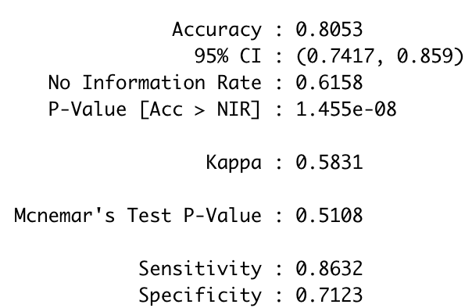
For Live Session: Part 1 (3-5 hours)
Download the training set: Connect to the opendatasoft website and download the random sample of 891 Titanic Passengers. This is the training set. The data come in JSON form format and you can use this URL to access the data:
https://public.opendatasoft.com/api/records/1.0/search/?dataset=titanic-passengers&rows=2000&facet=survived&facet=pclass&facet=sex&facet=age&facet=embarked
Hint: This is not trivial. I recommend that you use the jsonlite package (fromJSON()) and RCurl package (getURL()) to access the data. (We covered this in Unit 4).
Try your best to access the data using the URL. You may also find the data (titanic_train.csv) on github. We will go over this data ingestion in live session.
Use KNN to classify those who survived and died based on Age and class.
Use your age and predict your survival based on each of the ticket classes.
Use your model to classify the 418 randomly selected passengers in the test set (titanic_test.csv) on github.
Create a confusion matrix and calculate the accuracy, misclassification rate, sensitivity and specificity. Be prepared to explain these statistics. (It is ok if you have questions here… we will answer them in live session … just do your best in the time allotted.)
Make a PowerPoint to present in Live Session
BONUS: Create separate models for males and females and compare the resulting classification statistics after using the models to classify those in the test set.
Before M/F in Model
After M/F in Model

Slide 9
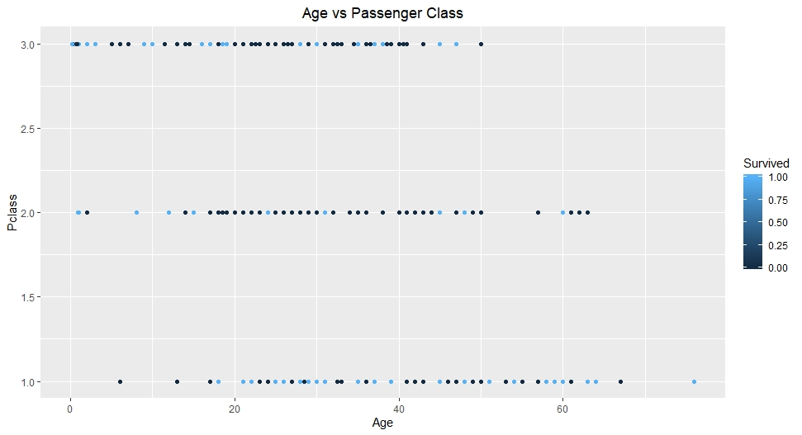
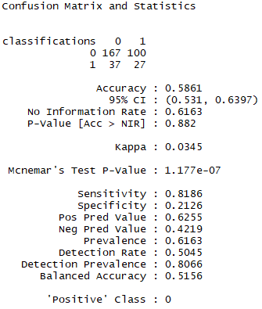
Part 1
Test set had 331 passengers with data.
I calculated the optimal k of 30 (or near 5) to get a better classification and confusion matrix
Notes:
library(class)
library(caret)
library(e1071)
library(tidyverse)
library(ggplot2)
library(dplyr)
# set seed
set.seed(8)
# splitPerc = .75
# Read in csv files
test = read.csv("~/03-School/DS 6306/Unit6/titanic_test.csv")
train = read.csv("~/03-School/DS 6306/Unit6/titanic_train.csv")
newData = read.csv("~/03-School/DS 6306/Unit6/gender_submission.csv")
# add new data not on GitHub
test = merge(test, newData, by = "PassengerId")
# tidy data by re-ordering new data to match test to train
test = test[,c(1,12,2,3,4,5,6,7,8,9,10,11)]
# omit n/a data
test <- na.omit(test)
train <- na.omit(train)
# Plot the age vs fare graphs
test %>% ggplot(aes(x = Age, Pclass,color = Survived)) + geom_point() + ggtitle("Age vs Passenger Class") + theme(plot.title = element_text(hjust = 0.5))
train %>% ggplot(aes(x = Age, Pclass,color = Survived)) + geom_point() + ggtitle("Age vs Passenger Class") + theme(plot.title = element_text(hjust = 0.5))
# find the confustion matrix and classification table
classifications = knn(train[,c(3,6)],test[,c(3,6)],train$Survived, prob = TRUE, k = 30)
table(classifications,test$Survived)
confusionMatrix(table(classifications,test$Survived))
# Find the best k-value and graph it
accs = data.frame(accuracy = numeric(30), k = numeric(30))
for(i in 1:30)
{
classifications = knn(train[,c(3,6)],test[,c(3,6)],train$Survived, prob = TRUE, k = i)
table(test$Survived,classifications)
CM = confusionMatrix(table(test$Survived,classifications))
accs$accuracy[i] = CM$overall[1]
accs$k[i] = i
}
plot(accs$k,accs$accuracy, type = "l", xlab = "k")
# make male and female test, train data frames
mtest <- filter(test, Sex == "male")
mtrain <- filter(train, Sex == "male")
ftest <- filter(test, Sex == "female")
ftrain <- filter(train, Sex == "female")
# Plot the age vs fare graphs for female first
ftest %>% ggplot(aes(x = Age, Pclass,color = Survived)) + geom_point() + ggtitle("Age vs Passenger Class") + theme(plot.title = element_text(hjust = 0.5))
ftrain %>% ggplot(aes(x = Age, Pclass,color = Survived)) + geom_point() + ggtitle("Age vs Passenger Class") + theme(plot.title = element_text(hjust = 0.5))
# find the confustion matrix and classification table
classifications = knn(ftrain[,c(3,6)],ftest[,c(3,6)],ftrain$Survived, prob = TRUE, k = 30)
table(classifications,ftest$Survived)
confusionMatrix(table(classifications, ftest$Survived))
# Find the best k-value and graph it
accs = data.frame(accuracy = numeric(30), k = numeric(30))
for(i in 1:30)
{
classifications = knn(ftrain[,c(3,6)],ftest[,c(3,6)],ftrain$Survived, prob = TRUE, k = i)
table(ftest$Survived,classifications)
CM = confusionMatrix(table(ftest$Survived,classifications))
accs$accuracy[i] = CM$overall[1]
accs$k[i] = i
}
# Plot the age vs fare graphs for males
mtest %>% ggplot(aes(x = Age, Pclass,color = Survived)) + geom_point() + ggtitle("Age vs Passenger Class") + theme(plot.title = element_text(hjust = 0.5))
mtrain %>% ggplot(aes(x = Age, Pclass,color = Survived)) + geom_point() + ggtitle("Age vs Passenger Class") + theme(plot.title = element_text(hjust = 0.5))
# find the confustion matrix and classification table
classifications = knn(mtrain[,c(3,6)],mtest[,c(3,6)],mtrain$Survived, prob = TRUE, k = 30)
table(classifications,mtest$Survived)
confusionMatrix(table(classifications, mtest$Survived))
# Find the best k-value and graph it
accs = data.frame(accuracy = numeric(30), k = numeric(30))
for(i in 1:30)
{
classifications = knn(mtrain[,c(3,6)],mtest[,c(3,6)],mtrain$Survived, prob = TRUE, k = i)
table(mtest$Survived,classifications)
CM = confusionMatrix(table(mtest$Survived,classifications))
accs$accuracy[i] = CM$overall[1]
accs$k[i] = i
}

Slide 10
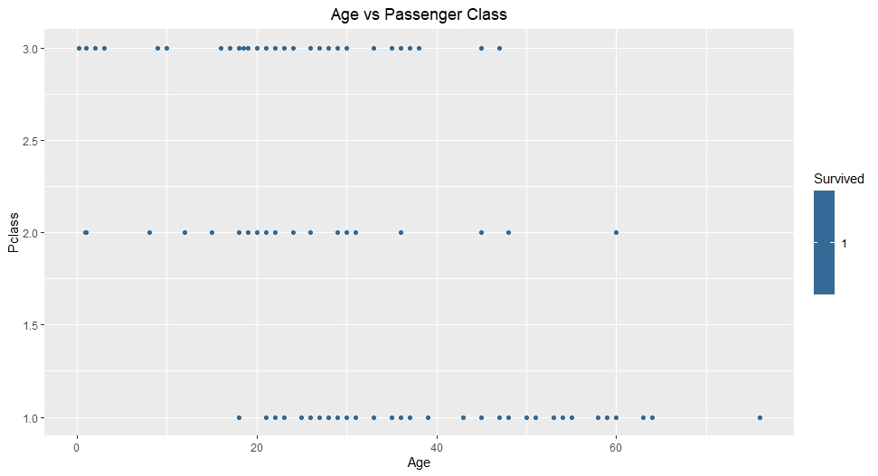
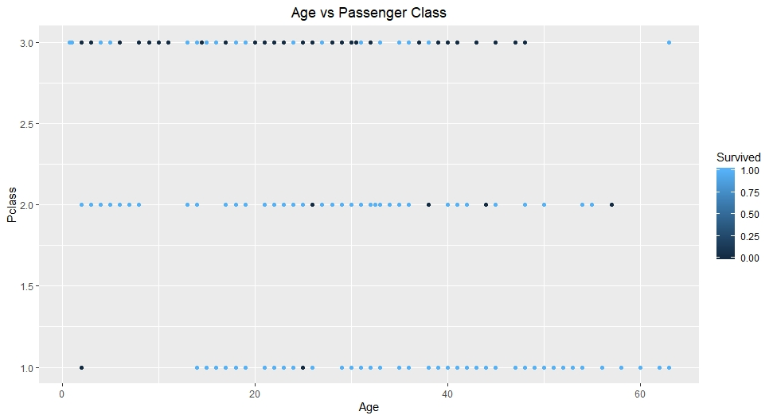
Part 1 continued
Women survivors
I looked at both the test and train data sets.
100% of the women survived in the test data set
Most of the women in 1st and 2nd class survived in the Train dataset

Slide 11
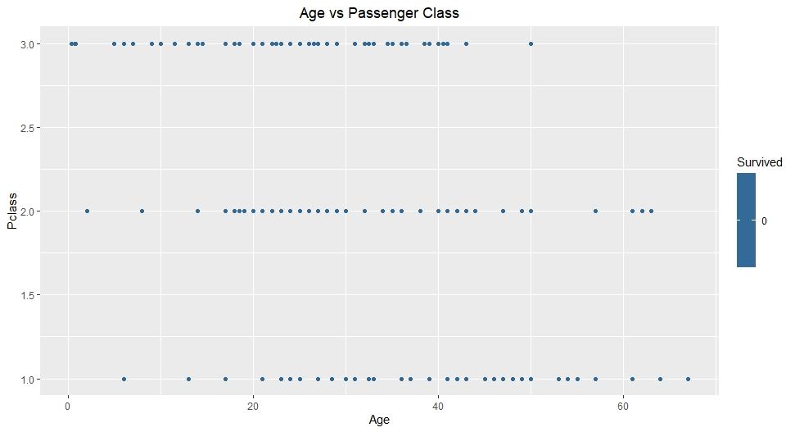
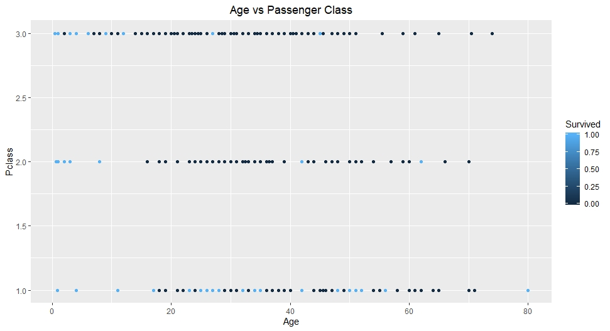
Part 1 continued
Men survivors
I looked at both the test and train data sets.
100% of the men died in the test data set – including children
Most of the children in the train dataset survived.
Of the older men in the train dataset, most were from 1st and 2nd class

Slide 12
Sanjay

Slide 13
Malcom

Slide 14
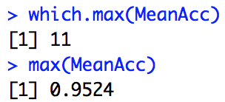
FOR LIVE SESSION: Part 2
#For Live Session
#Use a 70 - 30 train/test split to use cross validation to
#tune the hyperparameter k for the full (multinomial) IRIS data.
# Report the highest accuracy rate the and the k that produced it.
set.seed(1)
iterations = 500
numks = 60
splitPerc = .8
masterAcc = matrix(nrow = iterations, ncol = numks)
for(j in 1:iterations)
{
trainIndices = sample(1:dim(iris)[1],round(splitPerc * dim(iris)[1]))
train = iris[trainIndices,]
test = iris[-trainIndices,]
for(i in 1:numks)
{
classifications = knn(train[,c(1,3)],test[,c(1,3)],train$Species, prob = TRUE, k = i)
table(classifications,test$Species)
CM = confusionMatrix(table(classifications,test$Species))
masterAcc[j,i] = CM$overall[1]
}
}
MeanAcc = colMeans(masterAcc)
plot(seq(1,numks,1),MeanAcc, type = "l")
which.max(MeanAcc)
max(MeanAcc)

Slide 15
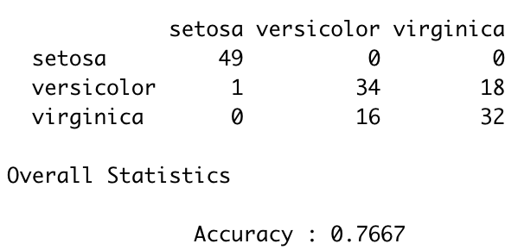
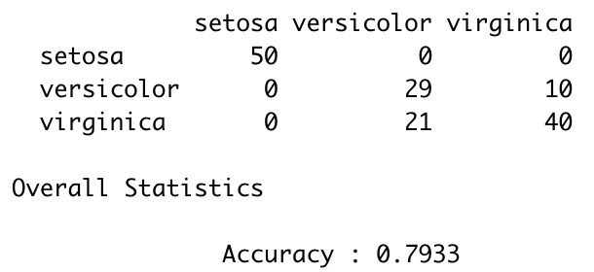
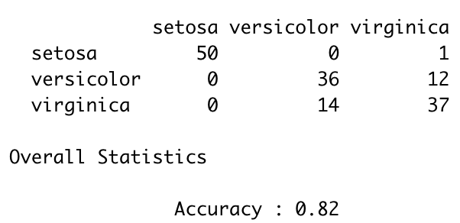
Example: Iris Data | Evaluation
#Leave 1 out CV
confusionMatrix(table(knn.cv(iris[,c(1,2)],iris[,5],k = 6),iris[,5]))
confusionMatrix(table(knn.cv(iris[,c(1,2)],iris[,5],k = 20),iris[,5]))
confusionMatrix(table(knn.cv(iris[,c(1,2)],iris[,5],k = 50),iris[,5]))

Slide 16
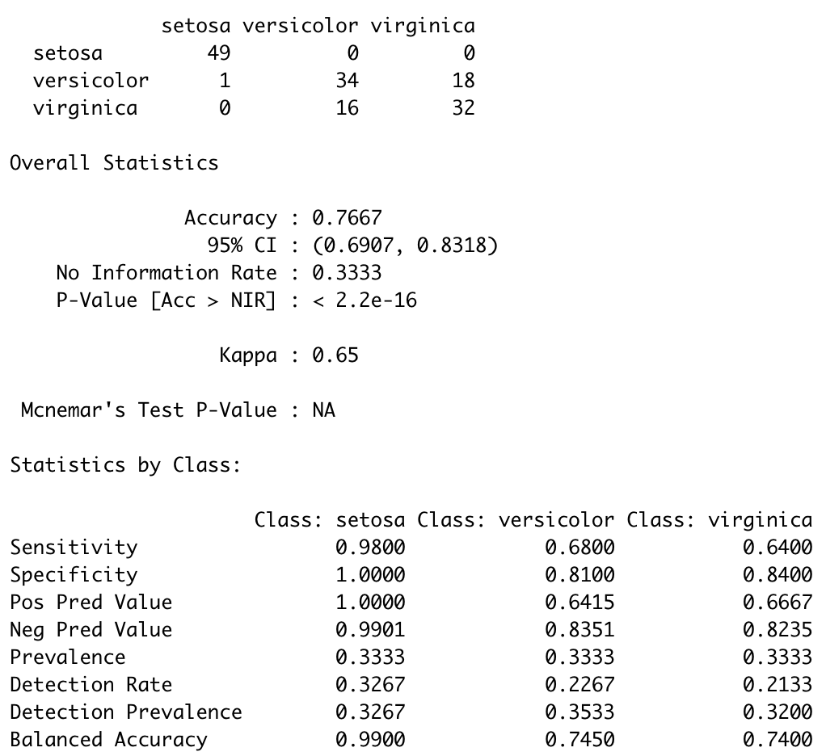
Multi-class Specificity and Sensitivity
Sensitivity for each class is the percent of that class that was classified correctly.
Specificity for Class X is the percentage of elements not in that class that were correctly classified as not being in that class (Class X).
Example:
Specificity:
Setosa: 1-((0+0) / (50 + 50))
Versicolor: 1-((1+18) / (50 + 50))
Virginica: 1-((0+16) / (50 + 50))

Slide 17
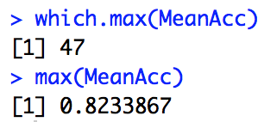
FOR LIVE SESSION QUESTION
#For the full (multinomial) IRIS data… do a leave one out cross validation with k 1 - 90 and using sepal length and width as predictors. Make a plot of k (xaxis) versus accuracy. Use this plot to tune the hyperparameter k. What do you feel is the best value of k?
set.seed(1)
iterations = 500
numks = 90
masterAcc = matrix(nrow = iterations, ncol = numks)
for(j in 1:iterations)
{
for(i in 1:numks)
{
CM = confusionMatrix(table(iris[,5],knn.cv(iris[,c(1,2)],iris[,5],k = i)))
masterAcc[j,i] = CM$overall[1]
}
}
MeanAcc = colMeans(masterAcc)
plot(seq(1,numks,1),MeanAcc, type = "l")
which.max(MeanAcc)
max(MeanAcc)

Slide 18
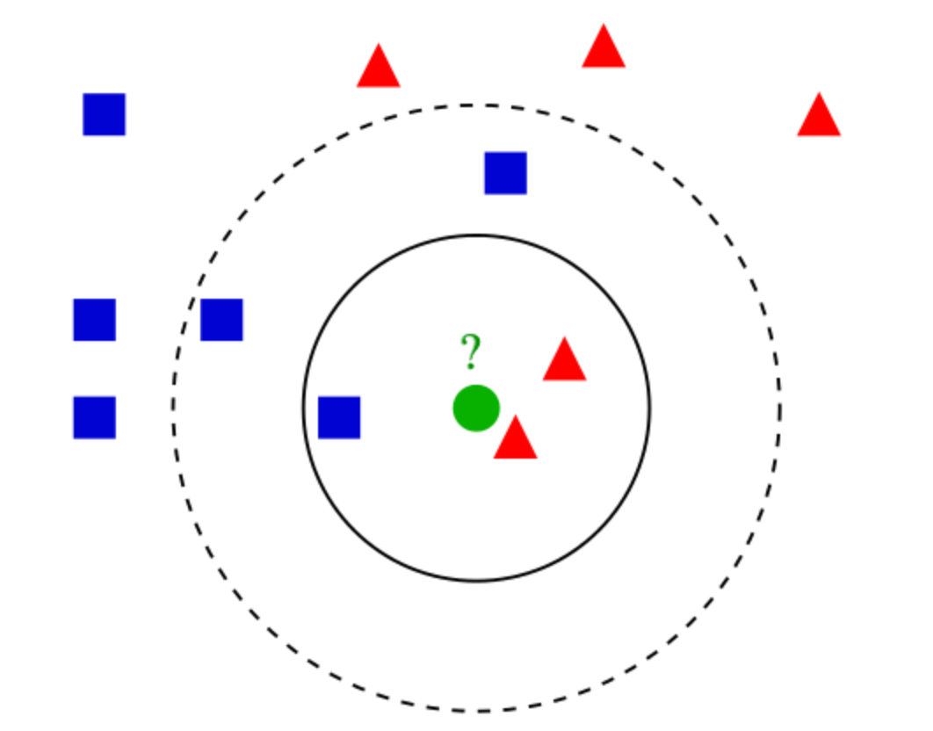
K-Nearest Neighbors (k-NN) .. You are the average of your k closest friends
Non-parametric: no speculation about the model function f before training the model (its determined from data)
Lazy “instance based” learner: no training required but may take more time predicting.
Intuition: consider the most similar items in terms of attributes, and give the unlabeled item the majority vote label. (in case of a tie, randomly select from top labels).
Check out this great video on KNN!
https://www.youtube.com/watch?v=MDniRwXizWo

Slide 19
K-NN algorithm
How to define similarity or closeness?
***Standardization: scale of attributes matters (e.g., age vs income --> income would dominate due its size)
Various measures exist such as:
Euclidean distance: for variables on the same scale
Cosine distance
Jaccard similarity
Mahalanobis Distance
Hamming Distance
Many others…

Slide 20
How many neighbors to look at? --> the value “k”
Typically k = square-root of n (number of instances)
Use cross-validation to tune the value of k:
i) Split training data into n folds or segments
ii) Training on n-1 folds and test on hold-out fold
iii) Pick whichever k that gives the lowest error across all iterations

Slide 21
High values of k prevent overfitting but if the value is too high it can be biased
E.g., k = N, all test data would be classified as the mean/mode of training data
kNN modeling assumptions:
i) Data is in a feature space where notion of ‘distance’ makes sense
ii) Training data is classified into two or more classes
iii) Need to choose the value of k = number of neighbors
iv) Observed features and labels are somehow related

Slide 22
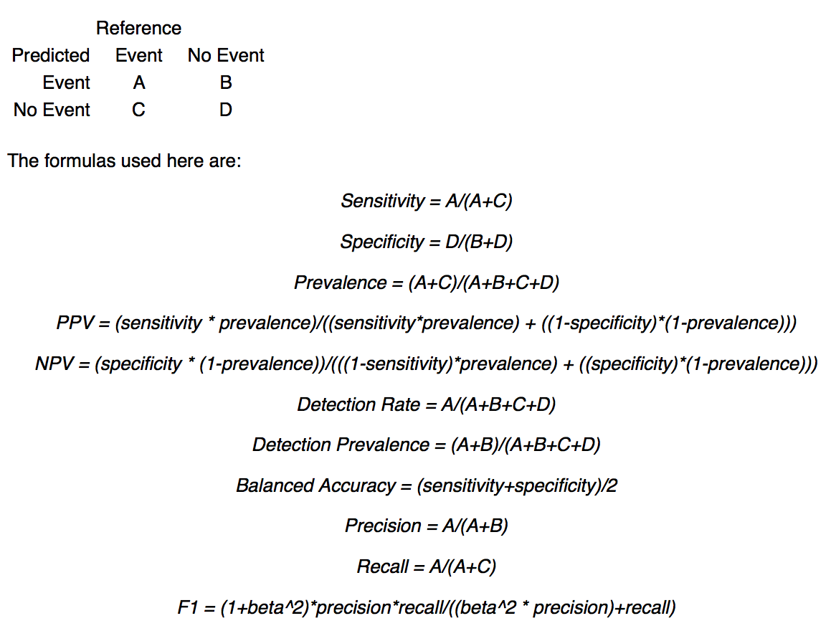
Classification Metrics
Accuracy = (A+D) / (A + B + C + D)
* Note: from R Documentation for caret package.

Slide 23
kNN application areas:
Impute missing training data
Fraud detection (adapt fast to new data points)
“Similar search”: semantically similar documents or search items
A component in a more complex ensemble classification architecture
Can be used with categorical and continuous response variables (KNN Regression: Unit 10!).

